Slide 1

Statistics and Probability for Data Science

Slide 2
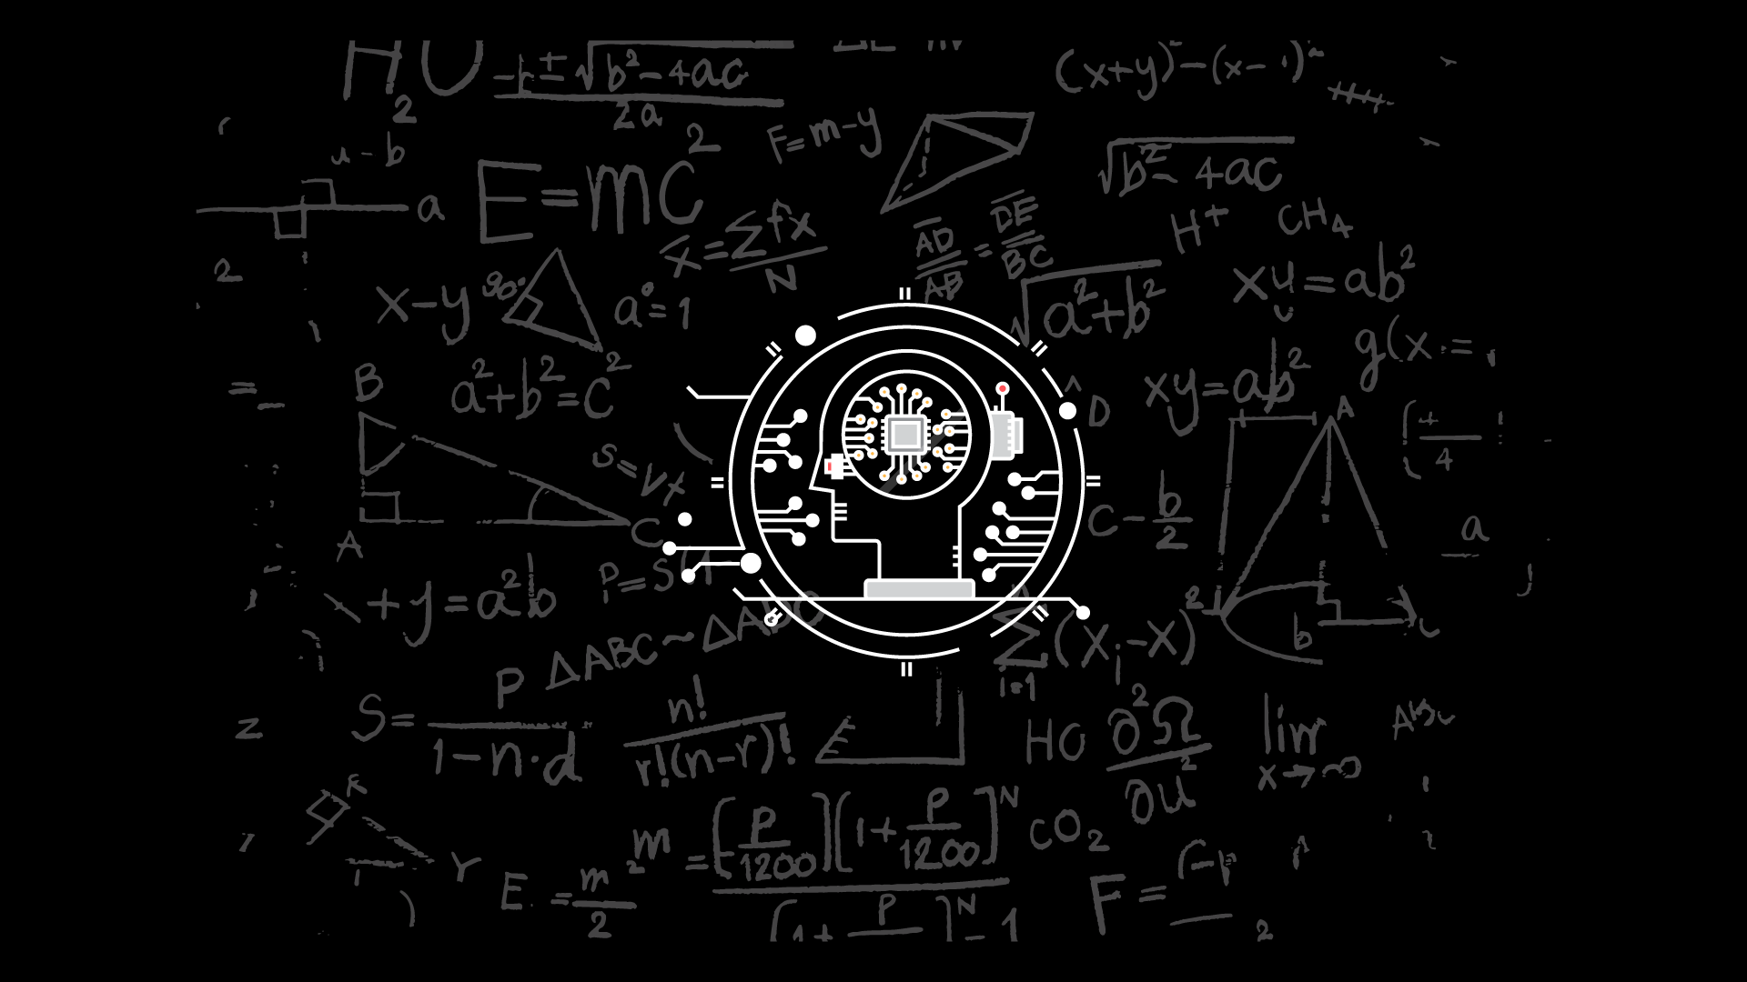
AGENDA
Introduction to Probability for Data Science
Introduction to Statistics for Data Science
Hands-On

Slide 3

Important Note:
Please make sure you open and show these pages:
Meetup: https://www.meetup.com/edureka/
Edureka Webinar: https://www.edureka.co/webinars
Course Landing Page( Slide 5 and 6 )(link has been added on the comments)

Slide 4





Join Our
Community
EDUREKA MASTERCLASS
Join here:
www.meetup.com/edureka
Register here:
www.edureka.co/webinars
sales@edureka.co
www.edureka.co
IN:9606058406
US:18338555775

Slide 5

Edureka Certification Training
Features | Data Science with Python Certification Training
Instructor-led Live Session
24*7 Doubt Clearing Support
Edureka Certification
Assignments/Projects/Case studies/Hands-On
Hours of LIVE Class | 42 hours

Slide 6


Live Online Class

Slide 7






Association Rules Mining and Recommendation Systems
8
Hands-On
Unsupervised Learning
10
9
Reinforcement Learning
Hands-On
Introduction to NumPy, Pandas and Matplotlib
Hands-On
7
Introduction
5
Hands-On
Dimensionality Reduction
Sequences and File Operations
Hands-On
4
6
Hands-On
1
2
Introduction to Machine Learning with Python
Hands-On
Data Manipulation
Hands-On
3
Deep Dive – Functions, OOPs, Modules, Errors and Exceptions
Hands-On
Data Science with Python Certification Training Course

Slide 8

1
Probability

Slide 9

Probability
Probability is the measure of how likely an event will occur.
Probability is the ratio of desired outcomes to total outcomes:
(desired outcomes) / (total outcomes)
Probabilities of all outcomes always sums to 1
Example:
On rolling a dice, you get 6 possible outcomes
Each possibility only has one outcome, so each has a probability of 1/6
For example, the probability of getting a number ‘2’ on the dice is 1/6

Slide 10
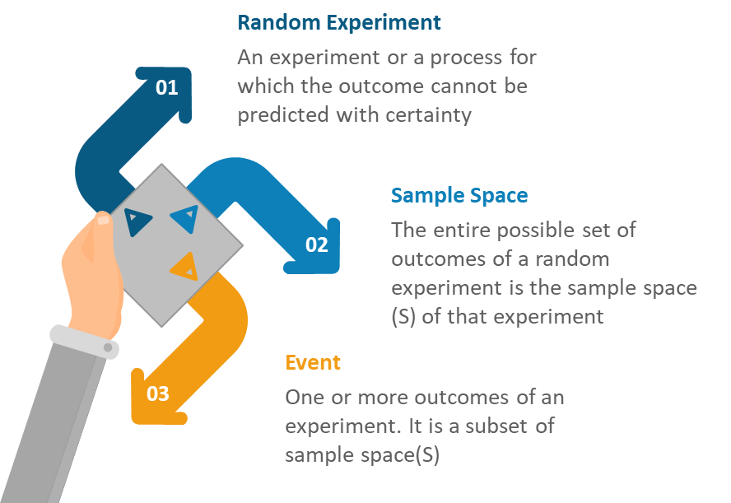

Probability - Terminologies

Slide 11
Probability – Types of Events
Joint Events can have common outcomes
A student can get 100 marks in statistics and 100 marks in probability
The outcome of a ball delivered can be a no ball and a six
Disjoint Events do not have any common outcomes.
The outcome of a ball delivered cannot be a sixer and a wicket
A single card drawn from a deck cannot be a king and a queen
A man cannot be dead and alive

Slide 12
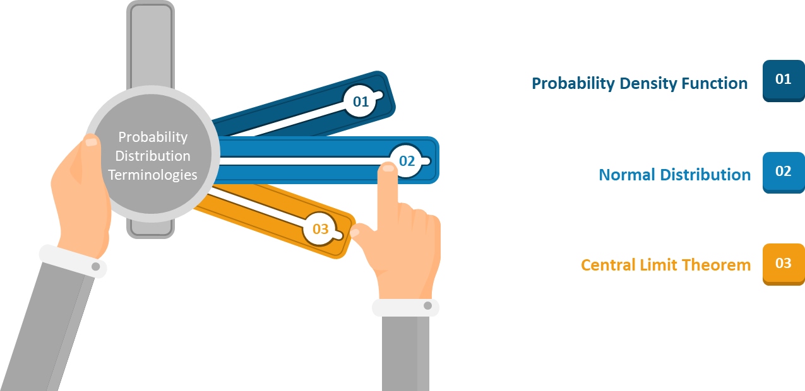
Probability – Distributions

Slide 13
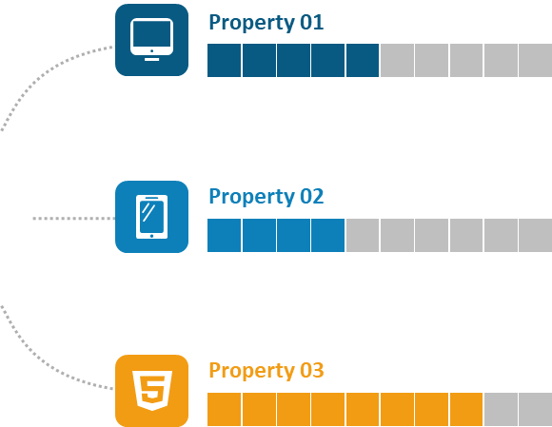
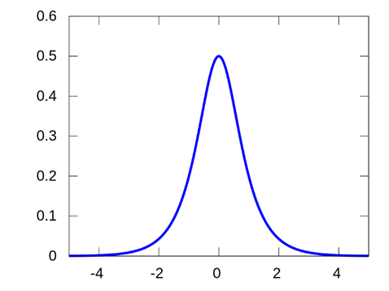
Probability – PDF
The equation describing a continuous probability distribution is called a Probability Density Function
Graph of a PDF will be continuous over a range
Area bounded by the curve of density function and the x-axis is equal to 1
Probability that a random variable assumes a value between a & b is equal to the area under the PDF bounded by a & b
a
b

Slide 14
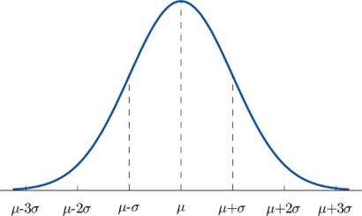

Probability – Normal Distribution
The Normal Distribution is a probability distribution that associates the normal random variable X with a cumulative probability
Y = [ 1/σ * sqrt(2π) ] * e ^{-(x - μ)2/2σ2}
Where,
X is a normal random variable
μ is the mean and
σ is the standard deviation
Note: Normal Random variable is variable with mean at 0 and variance equal to 1

Slide 15
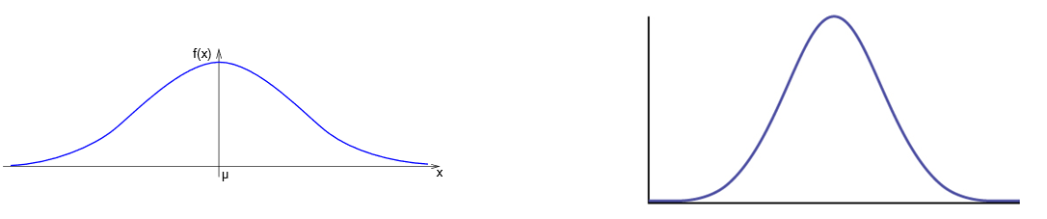
Probability – Normal Distribution
The graph of the Normal Distribution depends on two factors: the Mean and the Standard Deviation
Mean: Determines the location of center of the graph
Standard Deviation: Determines the height of the graph
If the standard deviation is large, the curve is short and wide.
If the standard deviation is small, the curve is tall and narrow.

Slide 16
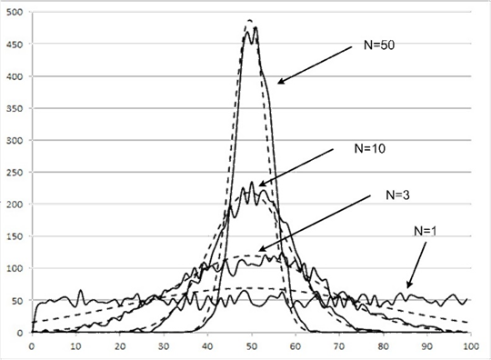
Probability – Central Limit Theorem
The Central Limit Theorem states that the sampling distribution of the mean of any independent, random variable will be normal or nearly normal, if the sample size is large enough

Slide 17
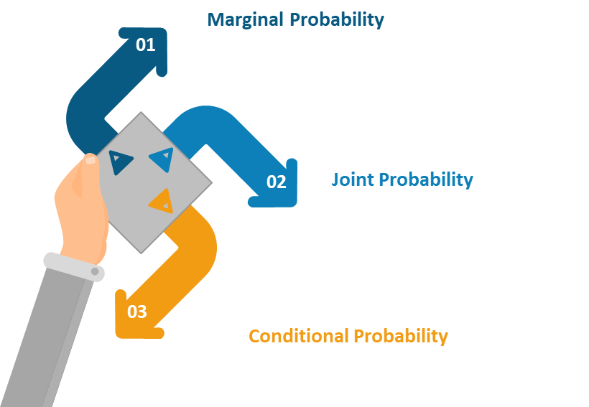
Probability – Types of Probability

Slide 18
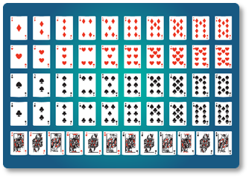
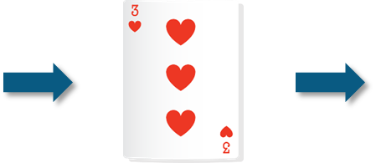
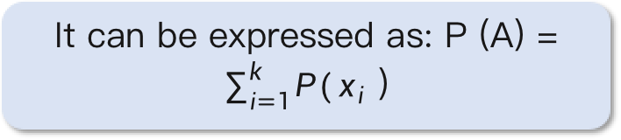
Probability – Marginal Probability
Marginal Probability is the probability of occurrence of a single event.
Marginal Probability = 13
52
It can be expressed as: P (A) = $\sum_{i=1}^{k}{P(}x_{i}$ )

Slide 19
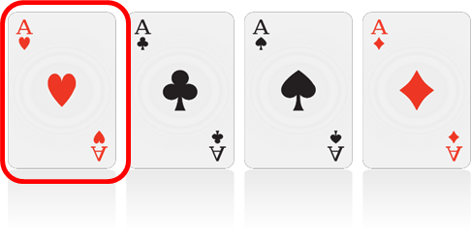

Probability – Joint Probability
Joint Probability is a measure of two events happening at the same time
Example: The probability that a card is an Ace of hearts = P (Ace of hearts)
(There are 13 heart cards in a deck of 52 and out of them one in the Ace of hearts)

Slide 20
Probability – Conditional Probability
Probability of an event or outcome based on the occurrence of a previous event or outcome
Conditional Probability of an event B is the probability that the event will occur given that an event A has already occurred
If A and B are dependent events then the expression for conditional probability is given by:
P (B|A) = P (A and B) / P (A)
If A and B are independent events, then the expression for conditional probability is given by:
P(B|A) = P (B)

Slide 21
Probability – Bayes Theorem
Shows the relation between one conditional probability and its inverse
P (B|A) is referred to as likelihood ratio which measures the probability (given event A) of occurrence of B
P (A) is referred to as Prior which represents the actual probability distribution of A
P (A|B) = P (B|A) P (A) P (B)
P (A|B) is referred to as posterior which means the probability of occurrence of A given B

Slide 22

Probability – Bayes Theorem Example
Suppose you run a clinic where you test if a patient has Liver problems or not
Probability that they drink even though they have a liver problem may be around 5%. [P(A/B)]
Prior probability that around 10% of your patients from before have had problems. [P(A)]
Hence the probability that they do have a liver problem is calculated now by,
Probability that the patient drinks. Let’s say it is 15%. [P(B)]
P(B/A) = (0.05*0.10) / 0.15 = 0.0333 -> 3.33%

Slide 23

Probability– Applications
Probability helps us optimize our model
Classification by our algorithms requires Probability
Loss can also be calculated using Probability
Models are built on Probability

Slide 24
2
Statistics

Slide 25

Statistics
Statistics is an area of applied mathematics concerned with the data collection, analysis, interpretation and presentation.
For Example: Your company has created a new drug that may cure cancer. How would you conduct a test to confirm the drug's effectiveness?

Slide 26




Statistics - Terminologies
Statistics Terminologies
Population: A collection or set of individuals or objects or events whose properties are to be analyzed.
Sample: A subset of population is called ‘Sample’. A well-chosen sample will contain most of the information about a population parameter
Population
Sample

Slide 27
3
Sampling Techniques

Slide 28
Statistics – Sampling Techniques
Sampling
Probability
Non-probability
Random
Stratified
Snowball
Convenience
Judgement
Systematic
Quota

Slide 29

Statistics – Random Sampling
Random Sampling
Systematic Sampling
Each member of the population has equal chance of being selected in the sample.
Stratified Sampling

Slide 30

Statistics – Systematic Sampling
Random Sampling
1 2 3
Every nth record is chosen
2
4
6
4 5 6
Systematic Sampling
Every 2nd record is chosen
In Systematic sampling every nth record is chosen from the population to be a part of the sample.
Stratified Sampling

Slide 31


Statistics – Stratified Sampling
Random Sampling
Male subset
Chosen sample
Systematic Sampling
Female subset
A stratum is a subset of the population that shares at least one common characteristic, in this case it’s gender.
Random sampling is used to select a sufficient number of subjects from each stratum.
Stratified Sampling

Slide 32
4
Types of Statistics

Slide 33


Statistics – Types of Statistics
Maximum
Descriptive statistics uses the data to provide descriptions of the population, either through numerical calculations or graphs or tables.
Average
Minimum
Descriptive Statistics is mainly focused upon the main characteristics of data. It provides graphical summary of the data.

Slide 34
Statistics – Types of Statistics
Large
Inferential statistics makes inferences and predictions about a population based on a sample of data taken from the population in question.
Medium
Small
Inferential statistics, generalizes a large dataset and applies probability to draw a conclusion. It allows us to infer data parameters based on a statistical model using a sample data.

Slide 35
Statistics – Descriptive Statistics
Descriptive statistics is a method used to describe and understand the features of a specific data set by giving short summaries about the sample and measures of the data.
Descriptive statistics is broken down into two categories:
Measures of central tendency
Measures of variability (spread)

Slide 36
Statistics – Descriptive Statistics
Descriptive statistics is a method used to describe and understand the features of a specific data set by giving short summaries about the sample and measures of the data.
Descriptive statistics are broken down into two categories:
Measures of Central tendency
Measures of Variability (spread)
Measures of Centre
Mean
Median
Mode

Slide 37
Statistics – Descriptive Statistics
Descriptive statistics is a method used to describe and understand the features of a specific data set by giving short summaries about the sample and measures of the data.
Descriptive statistics are broken down into two categories:
Measures of Central tendency
Measures of Variability (spread)
Measures of Spread
Range
Inter Quartile Range
Variance
Standard Deviation

Slide 38
5
Measures of Center

Slide 39
Statistics – Measures of Center
Cars | mpg | cyl | disp | hp | drat
MazdaRX4 | 21 | 6 | 160 | 110 | 3.9
MazdaRX4_WAG | 21 | 6 | 160 | 110 | 3.9
Datsun_710 | 22.8 | 4 | 108 | 93 | 3.85
Alto | 21.3 | 6 | 108 | 96 | 3
WagonR | 23 | 4 | 150 | 90 | 4
Toyata_ 11 | 23 | 6 | 108 | 110 | 3.9
Honda_12 | 23 | 4 | 160 | 110 | 3.9
Ford_11 | 23 | 6 | 160 | 110 | 3.9
Here is a sample dataset of cars containing the variables:
Cars,
Mileage per Gallon(mpg)
Cylinder Type (cyl)
Displacement (disp)
Horse Power(hp)
Real Axle Ratio(drat)
Mean
Measure of average of all the values in a sample is called Mean.

Slide 40
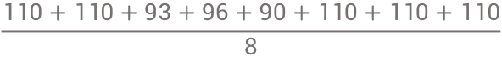
Statistics – Measures of Center
Cars | mpg | cyl | disp | hp | drat
MazdaRX4 | 21 | 6 | 160 | 110 | 3.9
MazdaRX4_WAG | 21 | 6 | 160 | 110 | 3.9
Datsun_710 | 22.8 | 4 | 108 | 93 | 3.85
Alto | 21.3 | 6 | 108 | 96 | 3
WagonR | 23 | 4 | 150 | 90 | 4
Toyata_ 11 | 23 | 6 | 108 | 110 | 3.9
Honda_12 | 23 | 4 | 160 | 110 | 3.9
Ford_11 | 23 | 6 | 160 | 110 | 3.9
Here is a sample dataset of cars containing the variables:
Cars,
Mileage per Gallon(mpg)
Cylinder Type (cyl)
Displacement (disp)
Horse Power(hp)
Real Axle Ratio(drat)
$$\frac{110+110+93+96+90+110+110+110}{8}$$
= 103.625

Slide 41
Statistics – Measures of Center
Cars | mpg | cyl | disp | hp | drat
MazdaRX4 | 21 | 6 | 160 | 110 | 3.9
MazdaRX4_WAG | 21 | 6 | 160 | 110 | 3.9
Datsun_710 | 22.8 | 4 | 108 | 93 | 3.85
Alto | 21.3 | 6 | 108 | 96 | 3
WagonR | 23 | 4 | 150 | 90 | 4
Toyata_ 11 | 23 | 6 | 108 | 110 | 3.9
Honda_12 | 23 | 4 | 160 | 110 | 3.9
Ford_11 | 23 | 6 | 160 | 110 | 3.9
Here is a sample dataset of cars containing the variables:
Cars,
Mileage per Gallon(mpg)
Cylinder Type (cyl)
Displacement (disp)
Horse Power(hp)
Real Axle Ratio(drat)
Median
Measure of the central value of the sample set is called Median.

Slide 42
Statistics – Measures of Center
Cars | mpg | cyl | disp | hp | drat
MazdaRX4 | 21 | 6 | 160 | 110 | 3.9
MazdaRX4_WAG | 21 | 6 | 160 | 110 | 3.9
Datsun_710 | 22.8 | 4 | 108 | 93 | 3.85
Alto | 21.3 | 6 | 108 | 96 | 3
WagonR | 23 | 4 | 150 | 90 | 4
Toyata_ 11 | 23 | 6 | 108 | 110 | 3.9
Honda_12 | 23 | 4 | 160 | 110 | 3.9
Ford_11 | 23 | 6 | 160 | 110 | 3.9
Here is a sample dataset of cars containing the variables:
Cars,
Mileage per Gallon(mpg)
Cylinder Type (cyl)
Displacement (disp)
Horse Power(hp)
Real Axle Ratio(drat)
To find out the center value of mpg among the population of cars, arrange records in Ascending order, i.e., 21, 21, 21.3, 22.8, 23, 23, 23, 23
In case of even entries, take average of the two middle values, i.e. (22.8+23 )/2 = 22.9

Slide 43
Statistics – Measures of Center
Cars | mpg | cyl | disp | hp | drat
MazdaRX4 | 21 | 6 | 160 | 110 | 3.9
MazdaRX4_WAG | 21 | 6 | 160 | 110 | 3.9
Datsun_710 | 22.8 | 4 | 108 | 93 | 3.85
Alto | 21.3 | 6 | 108 | 96 | 3
WagonR | 23 | 4 | 150 | 90 | 4
Toyata_ 11 | 23 | 6 | 108 | 110 | 3.9
Honda_12 | 23 | 4 | 160 | 110 | 3.9
Ford_11 | 23 | 6 | 160 | 110 | 3.9
Here is a sample dataset of cars containing the variables:
Cars,
Mileage per Gallon(mpg)
Cylinder Type (cyl)
Displacement (disp)
Horse Power(hp)
Real Axle Ratio(drat)
Mode
The value most recurrent in the sample set is known as Mode.

Slide 44
Statistics – Measures of Center
Cars | mpg | cyl | disp | hp | drat
MazdaRX4 | 21 | 6 | 160 | 110 | 3.9
MazdaRX4_WAG | 21 | 6 | 160 | 110 | 3.9
Datsun_710 | 22.8 | 4 | 108 | 93 | 3.85
Alto | 21.3 | 6 | 108 | 96 | 3
WagonR | 23 | 4 | 150 | 90 | 4
Toyata_ 11 | 23 | 6 | 108 | 110 | 3.9
Honda_12 | 23 | 4 | 160 | 110 | 3.9
Ford_11 | 23 | 6 | 160 | 110 | 3.9
Here is a sample dataset of cars containing the variables:
Cars,
Mileage per Gallon(mpg)
Cylinder Type (cyl)
Displacement (disp)
Horse Power(hp)
Real Axle Ratio(drat)
To find the most common type of cylinder among the population of cars, check the value which is repeated most number of times, i.e., cylinder type 6

Slide 45
6
Measures of Speed

Slide 46
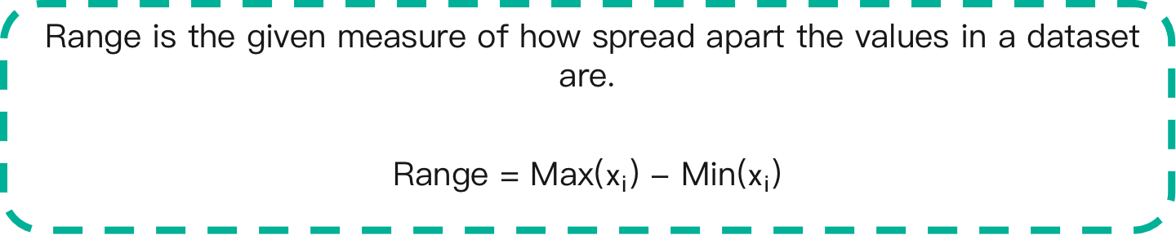
Statistics – Measures of Spread
A measure of spread, sometimes also called a measure of dispersion, is used to describe the variability in a
sample or population.
Range
Inter Quartile Range
Variance
Standard Deviation
Range is the given measure of how spread apart the values in a dataset are.
Range = Max($x_{i}$) - Min($x_{i}$)

Slide 47
Statistics – Measures of Spread
A measure of spread, sometimes also called a measure of dispersion, is used to describe the variability in a sample or population.
Range
Inter Quartile Range
Variance
Standard Deviation
Quartiles tell us about the spread of a data set by breaking the data set into quarters, just like the median breaks it in half.
Q1
Q2
Q3
1 2 3 4 5 6 7 8

Slide 48
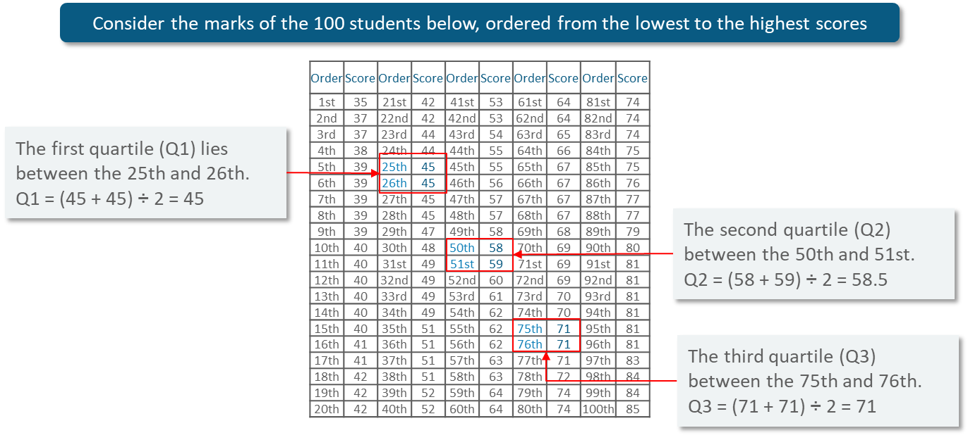
Statistics – Measures of Spread

Slide 49
Statistics – Measures of Spread
A measure of spread, sometimes also called a measure of dispersion, is used to describe the variability in a sample or population.
Range
Inter Quartile Range
Variance
Standard Deviation
Inter Quartile Range(IQR) is the measure of variability, based on dividing a dataset into quartiles.
Quartiles divide a rank-ordered data set into four equal parts, denoted by Q1, Q2, and Q3, respectively
The interquartile range is equal to Q3 minus Q1, i.e.. IQR = Q3 - Q1

Slide 50
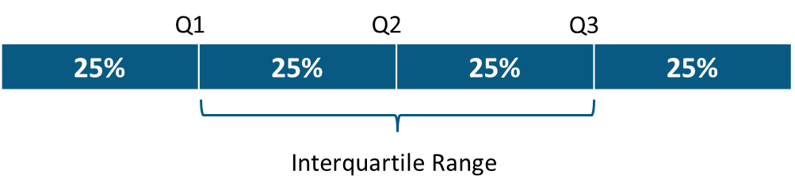
Statistics – Measures of Spread
A measure of spread, sometimes also called a measure of dispersion, is used to describe the variability in a
sample or population.
Range
Inter Quartile Range
Variance
Standard Deviation

Slide 51
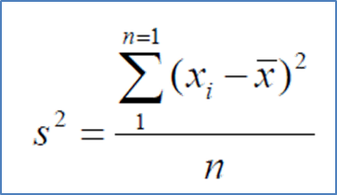
Statistics – Measures of Spread
A measure of spread, sometimes also called a measure of dispersion, is used to describe the variability in a
sample or population.
Range
Inter Quartile Range
Variance
Standard Deviation
Variance describes how much a random variable differs from its expected value.
It entails computing squares of deviations.
x : Individual data points
n : Total number of data points
x̅ : Mean of data points

Slide 52

Statistics – Measures of Spread
A measure of spread, sometimes also called a measure of dispersion, is used to describe the variability in a sample or population.
Range
Inter Quartile Range
Variance
Standard Deviation
Deviation is the difference between each element from the mean.
Deviation = ($x_{i}$-µ)

Slide 53
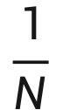
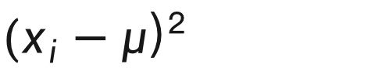
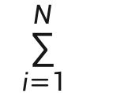
Statistics – Measures of Spread
A measure of spread, sometimes also called a measure of dispersion, is used to describe the variability in a sample or population.
Range
Inter Quartile Range
Variance
Standard Deviation
Population Variance is the average of squared deviations.
$$\frac{1}{N}$$
$$\sum_{i=1}^{N}{}$$
σ² =
${(x}_{i}−μ$)²

Slide 54
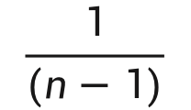
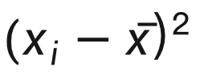
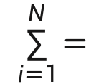
Statistics – Measures of Spread
A measure of spread, sometimes also called a measure of dispersion, is used to describe the variability in a
sample or population.
Range
Inter Quartile Range
Variance
Standard Deviation
Sample Variance is the average of squared differences from the mean.
$$\frac{1}{(n−1)}$$
$$\sum_{i=1}^{N}{=}$$
s² =
${(x}_{i}−\overline{x}$)²

Slide 55
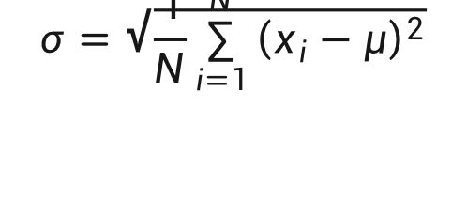
Statistics – Measures of Spread
A measure of spread, sometimes also called a measure of dispersion, is used to describe the variability in a
sample or population.
Range
Inter Quartile Range
Variance
Standard Deviation
Standard Deviation is the measure of the dispersion of a set of data from its mean.
$$σ=\sqrt{\frac{1}{N}\sum_{i=1}^{N}{{\left(x_{i}−μ\right)}^{2}}}$$

Slide 56
Statistics – Measures of Spread
Standard Deviation Use Case: Daenerys has 20 Dragons. They have the numbers 9, 2, 5, 4, 12, 7, 8, 11, 9, 3, 7, 4, 12, 5, 4, 10, 9, 6, 9, 4. Work out the Standard Deviation.
Find out the
mean for your sample set.
STEP 1
The Mean is:
9+2+5+4+12+7+8+11+9+3+7+4+12+5+4+10+9+6+9+4
20
⸫µ=7

Slide 57
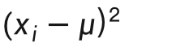
Statistics – Measures of Spread
Standard Deviation Use Case: Daenerys has 20 Dragons. They have the numbers 9, 2, 5, 4, 12, 7, 8, 11, 9, 3, 7, 4, 12, 5, 4, 10, 9, 6, 9, 4. Work out the Standard Deviation.
${(x}_{i}−μ$)²
Then for each number, subtract the Mean and square the result.
STEP 2
(9-7)²= 2²=4
(2-7)²= (-5)²=25
(5-7)²= (-2)²=4
And so on…
⸫ We get the following results:
4, 25, 4, 9, 25, 0, 1, 16, 4, 16, 0, 9, 25, 4, 9, 9, 4, 1, 4, 9

Slide 58

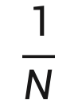
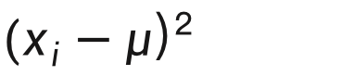
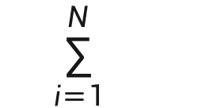
Statistics – Measures of Spread
Standard Deviation Use Case: Daenerys has 20 Dragons. They have the numbers 9, 2, 5, 4, 12, 7, 8, 11, 9, 3, 7, 4, 12, 5, 4, 10, 9, 6, 9, 4. Work out the Standard Deviation.
Then work out the mean of those squared differences.
$$\frac{1}{N}$$
$$\sum_{i=1}^{N}{}$$
STEP 3
σ =
${(x}_{i}−μ$)²
4+25+4+9+25+0+1+16+4+16+0+9+25+4+9+9+4+1+4+9
20
⸫ σ² = 8.9

Slide 59

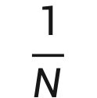
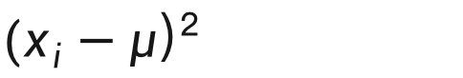
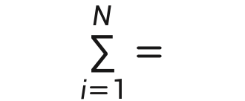
Statistics – Measures of Spread
Standard Deviation Use Case: Daenerys has 20 Dragons. They have the numbers 9, 2, 5, 4, 12, 7, 8, 11, 9, 3, 7, 4, 12, 5, 4, 10, 9, 6, 9, 4. Work out the Standard Deviation.
Take square root of σ².
STEP 4
$$\frac{1}{N}$$
$$\sum_{i=1}^{N}{=}$$
σ =
${(x}_{i}−μ$)²
⸫ σ = 2.983

Slide 60
7
Information Gain

Slide 61
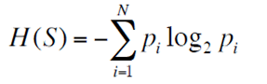
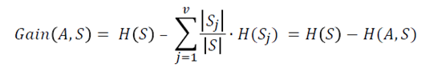
Statistics – Information Gain
Entropy
Information Gain (IG)
IG indicates how much “information” a particular feature/ variable gives us about the final outcome.
where:
H(S) – entropy of the whole dataset S
• |Sj| – number of instance with j value of an attribute A
• |S| – total number of instances in dataset S
• v – set of distinct values of an attribute A
• H(Sj) – entropy of subset of instances for attribute A
• H(A, S) – entropy of an attribute A
Entropy measures the impurity or uncertainty present in the data.
where:
S – set of all instances in the dataset
N – number of distinct class values
pi – event probability

Slide 62
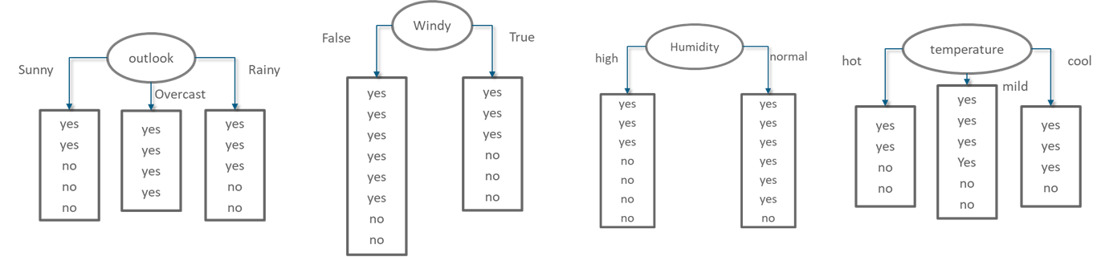
Statistics – Information Gain Example
Selecting the root variable

Slide 63
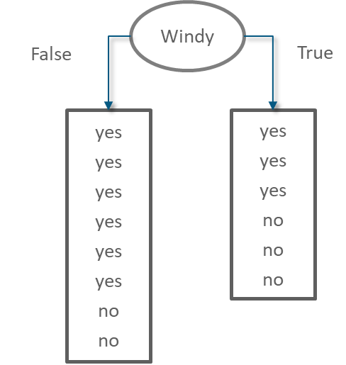
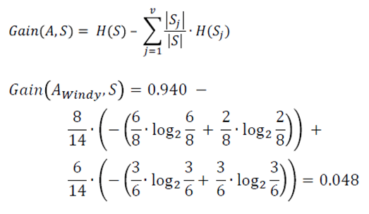
Statistics – Information Gain Example
Information Gain of attribute “windy”
From the total of 14 instances we have:
6 instances “true”
8 instances “false”

Slide 64
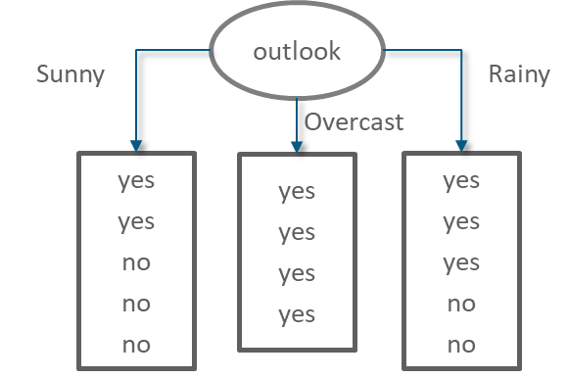
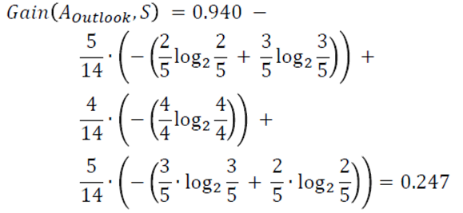
Statistics – Information Gain Example
Information Gain of attribute “outlook”
From the total of 14 instances we have:
5 instances “sunny”
4 instances “overcast”
5 instances “rainy”

Slide 65
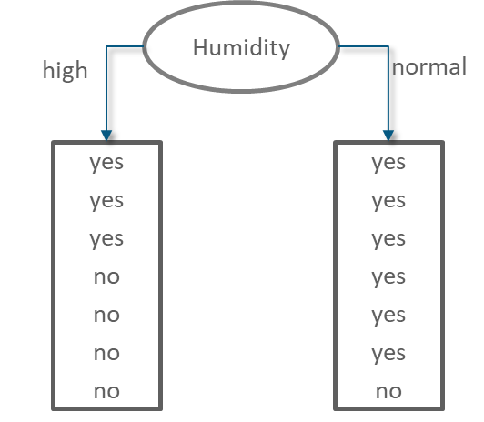
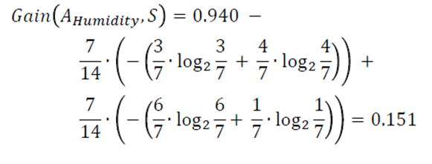
Statistics – Information Gain Example
Information Gain of attribute “humidity”
From the total of 14 instances we have:
7 instances “high”
7 instances “normal”

Slide 66
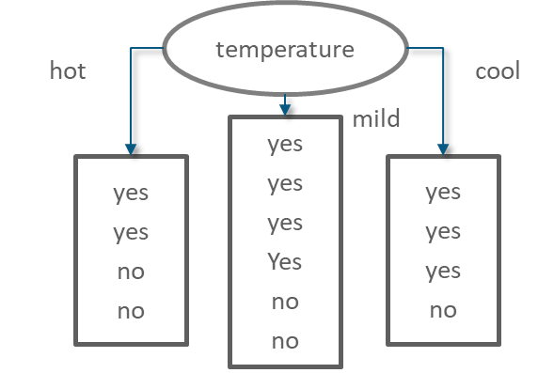
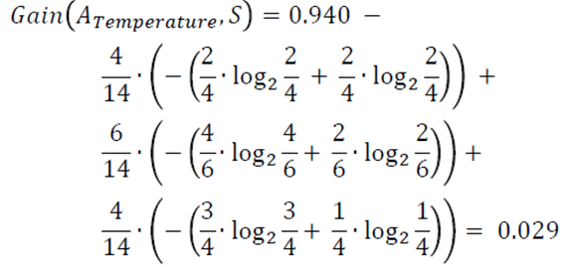
www.edureka.co
Statistics – Information Gain Example
Information Gain of attribute “temperature”
From the total of 14 instances we have:
4 instances “hot”
6 instances “mild”
4 instances “cool”

Slide 67
Statistics – Information Gain Example
Gain = 0.247
Gain = 0.048
Gain = 0.151
Gain = 0.029
The variable with the highest IG is used to split the data at the root node.

Slide 68
Statistics – Information Gain Example
Gain = 0.247
Gain = 0.048
Gain = 0.151
Gain = 0.029
The variable with the highest IG is used to split the data at the root node. The ‘Outlook’ variable has the highest IG, therefore it can be assigned to the root node.

Slide 69
8
Matrix

Slide 70
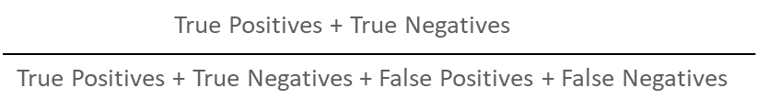
Statistics – Confusion Matrix
A confusion matrix is a table that is often used to describe the performance of a classification model (or "classifier") on a set of test data for which the true values are known.
Confusion Matrix represents a tabular representation of Actual vs Predicted values
You can calculate the accuracy of your model with:

Slide 71
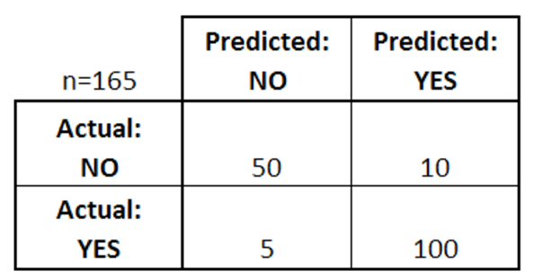
Statistics – Confusion Matrix
There are two possible predicted classes: "yes" and "no”
The classifier made a total of 165 predictions
Out of those 165 cases, the classifier predicted "yes" 110 times, and "no" 55 times
In reality, 105 patients in the sample have the disease, and 60 patients do not

Slide 72
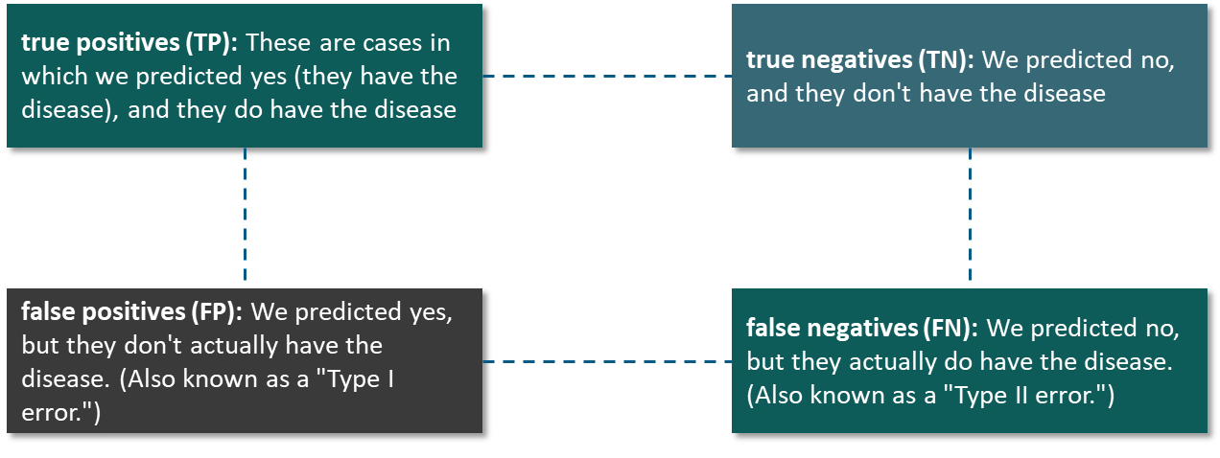

Statistics – Confusion Matrix

Slide 73
Statistics – Inferential Statistics
Inferential Statistics is a method where we infer and understand what the data wants to communicate with us
Inferential Statistics can be broken down into:
Point Estimation
Interval Estimation

Slide 74
9
Estimation

Slide 75

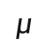
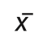
Statistics – Point Estimation
Point Estimation is concerned with the use of the sample data to measure a single value which serves as an approximate value or the best estimate of an unknown population parameter.
Point Estimation is concerned with the use of the sample data to measure a single value which serves as an approximate value or the best estimate of an unknown population parameter.
Population
Sample
Random
Estimate
$$μ$$
$$\overline{x}$$
Mean of Population
Sample Mean

Slide 76
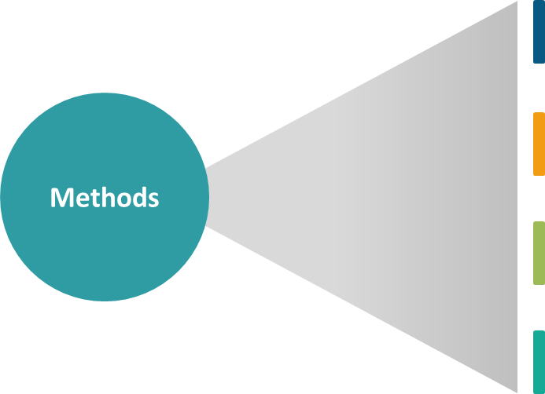
Statistics – Point Estimation
Method of Moments
Estimates are found out by equating the first k sample moments to the corresponding k population moments
Maximum of Likelihood
Uses a model and the values in the model to maximize a likelihood function. This results in the most likely parameter for the inputs selected
Bayes’ Estimators
Minimizes the average risk (an expectation of random variables)
Best Unbiased Estimators
Several unbiased estimators can be used to approximate a parameter (which one is “best” depends on what parameter you are trying to find)

Slide 77
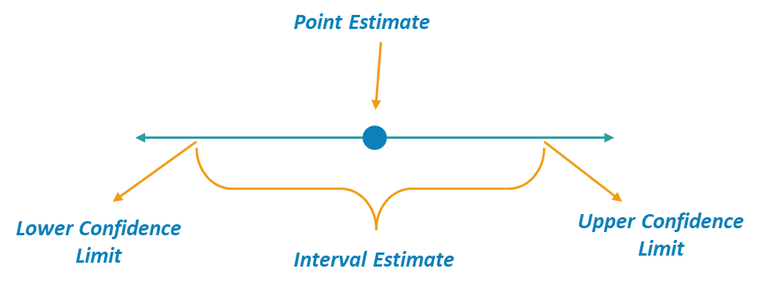
Statistics – Interval Estimate
An Interval, or range of values, used to estimate a population parameter is called Interval Estimate.

Slide 78
Statistics – Interval Estimate
01
Confidence Interval is the measure of your confidence, that the interval estimate contains the population mean, $μ$
Statisticians use a confidence interval to describe the amount of uncertainty associated with a sample estimate of a population parameter
02
Technically, a range of values so constructed that there is a specified probability of including the true value of a parameter within it
03

Slide 79


Statistics – Interval Estimate
Difference between the point estimate and the actual population parameter value is called the Sampling Error
When $μ$is estimated, the sampling error is the difference $μ$ - $\overline{x}$
Margin of Error E, for a given level of confidence is the greatest possible distance between the point estimate and the value of the parameter it is estimating

Slide 80

Statistics – Interval Estimate
The level of confidence c, is the probability that the interval estimate contains the population parameter.
C is the area beneath the normal curve between the critical values
Corresponding Z score can be calculated using the standard normal table

Slide 81

Statistics – Interval Estimate
If the level of confidence is 90%, this means that you are 90% confident that the interval contains
the population mean, 𝜇.
The Corresponding Z – scores are ± 1.645

Slide 82
10
Testing

Slide 83
Statistics – Hypothesis Testing
Statisticians use hypothesis testing to formally check whether the hypothesis is
accepted or rejected.
Hypothesis testing is conducted in the following manner:
State the Hypotheses – This stage involves stating the null and alternative hypotheses.
Formulate an Analysis Plan – This stage involves the construction of an analysis plan.
Analyse Sample Data – This stage involves the calculation and interpretation of the test statistic as described in the analysis plan.
Interpret Results – This stage involves the application of the decision rule described in the analysis plan.

Slide 84





Statistics – Hypothesis Testing
Nick John Bob Harry
Assume the event is free of bias.
So, what is the probability of John not cheating?

Slide 85

Statistics – Hypothesis Testing
Nick John Bob Harry
P(John not picked for a day) = $\frac{3}{4}$
P(John not picked for 3 days) = $\frac{3}{4}$ $×\frac{3}{4}×$ $\frac{3}{4}$ = 0.42 (approx)
P(John not picked for 12 days) = $(\frac{3}{4}) ^{12}$ = 0.032 $<0.05$

Slide 86


Statistics – Hypothesis Testing
Nick John Bob Harry
Null Hypothesis ($H_{0}$) : Result is no different from assumption.
Alternate Hypothesis ($H_{a}$) : Result disproves the assumption.
Probability of Event $<0.05$(5%)

Slide 87
Statistics – P & T Value
Suppose we want to find the heights of students greater than 5ft 7in
We say that this 6 out of 100 or 0.06 is the p-value of our hypothesis
We take a test of 100 students and find that the mean height is 5ft 9in
T-value is the testing and finding the most difference we can obtain between our assumption and dataset
A Hypothesis made that out of all the times we repeat this test, there will be at least 6 times that the mean is greater or equal than 5ft 9in
This is how the p-value and t-value help making in the null and alternate hypothesis

Slide 88
EDUREKA LMS

Slide 89
11
Hands-On

Slide 90
Thank You

